Slide 1
DevOps Training
SDLC
Intro DevOps and tools
Git – Source Code Management
Docker – Containerization
Kubernetes – Orchestration
Ansible – Infra as a Code (IaC)
Jenkins – Continuous Integration
Nagios – Continuous Monitoring

Slide 2
SDLC
Kapil Thakkar
DevOps Trainer

Slide 3
Introduction
SDLC is the acronym of Software Development Life Cycle.
SDLC, Software Development Life Cycle is a process used by software industry to design, develop and test high quality software’s.
The SDLC aims to produce a high quality software that meets or exceeds customer expectations, reaches completion within times and cost estimates.
It is also called as Software development process.
The software development life cycle (SDLC) is a framework defining tasks performed at each step in the software development process.

Slide 4

What is SDLC?
SDLC is a process followed for a software project, within a software organization.
It consists of a detailed plan describing how to develop, maintain, replace and alter or enhance specific software.
The life cycle defines a methodology for improving the quality of software and the overall development process.

Slide 5
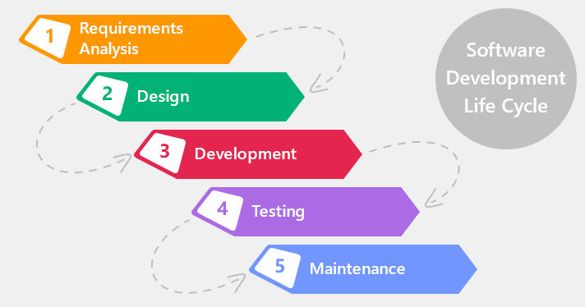
Software Development Life Cycle phases?

Slide 6

Requirement gathering and analysis:
Business requirements are gathered in this phase.
This phase is the main focus of the project managers and stake holders.
Meetings with managers, stake holders and users are held in order to determine the requirements like; who is going to use the system.

Slide 7

Design
In this phase the system and software design is prepared from the requirement specifications which were studied in the first phase.
System Design helps in specifying hardware and system requirements and also helps in defining overall system architecture.
The system design specifications serve as input for the next phase of the model.

Slide 8
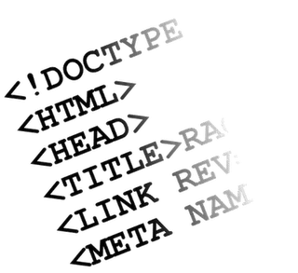
Development :
On receiving system design documents, the work is divided in modules/units and actual coding is started.
Since, in this phase the code is produced so it is the main focus for the developer. This is the longest phase of the software development life cycle.

Slide 9

Testing
After the code is developed it is tested against the requirements to make sure that the product is actually solving the needs addressed and gathered during the requirements phase.
During this phase unit testing, integration testing, system testing, acceptance testing are done.

Slide 10
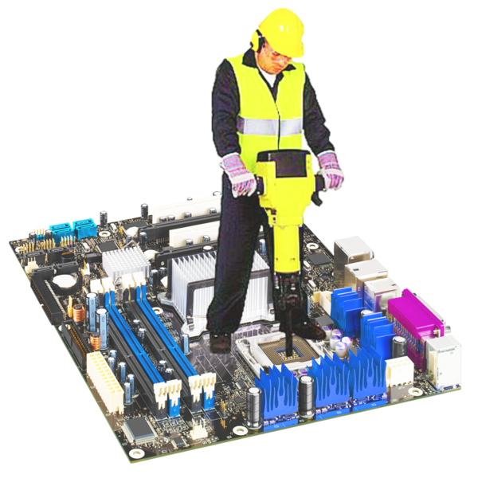
Maintenance
Once when the customers starts using the developed system then the actual problems comes up and needs to be solved from time to time.
This process where the care is taken for the developed product is known as maintenance.

Slide 11
Model of SDLC
There are a number of software development life cycle models and those are implemented during the process of software development. Some of the popular SDLC models are as follows:
Waterfall model
Iterative model (skip)
Spiral model (skip)
V-model (skip)
Agile SDLC Model

Slide 12
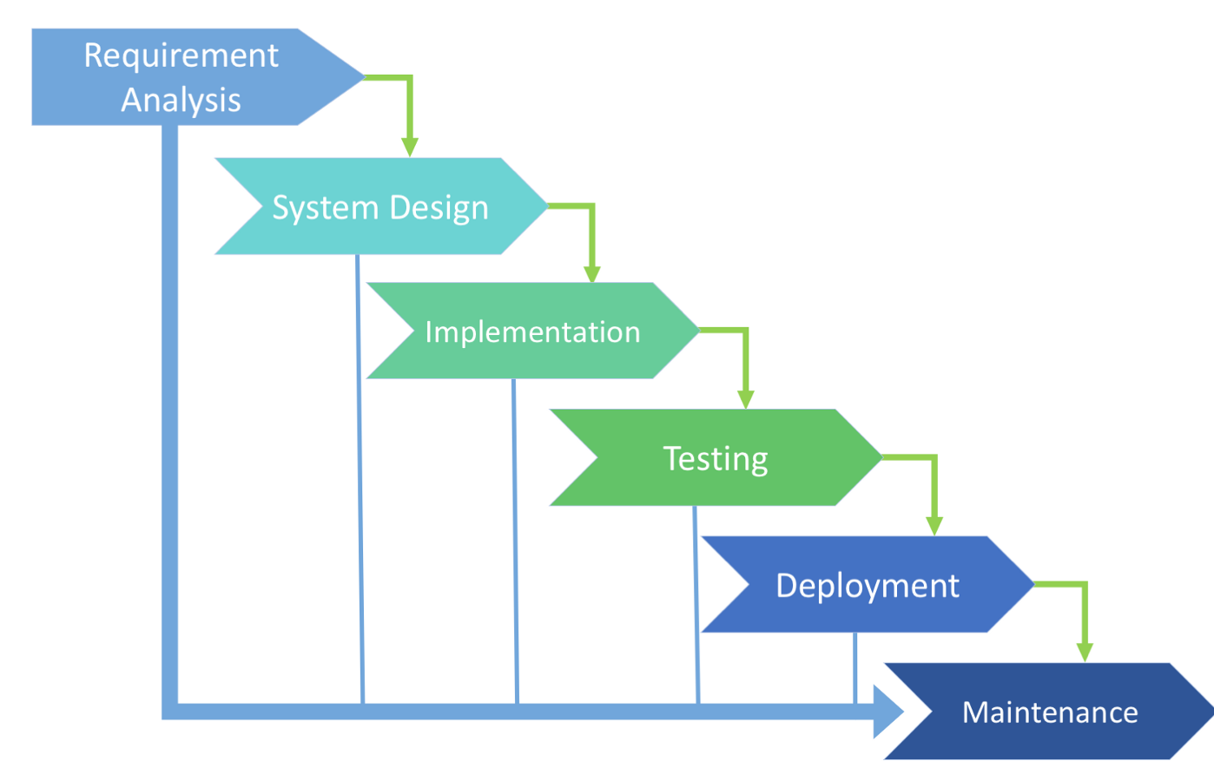
Waterfall
Waterfall — is a cascade SDLC model, in which development process looks like the flow, moving step by step through the phases of analysis, projecting, realization, testing, implementation, and support. This SDLC model includes gradual execution of every stage completely. This process is strictly documented and predefined with features expected to every phase of this software development life cycle model.

Slide 13
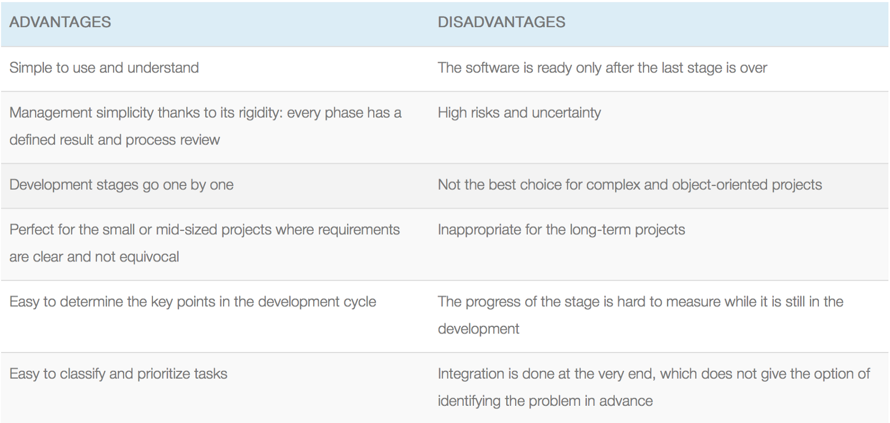
Use cases for the Waterfall SDLC model:
The requirements are precisely documented
Product definition is stable
The technologies stack is predefined which makes it not dynamic
No ambiguous requirements
The project is short

Slide 14
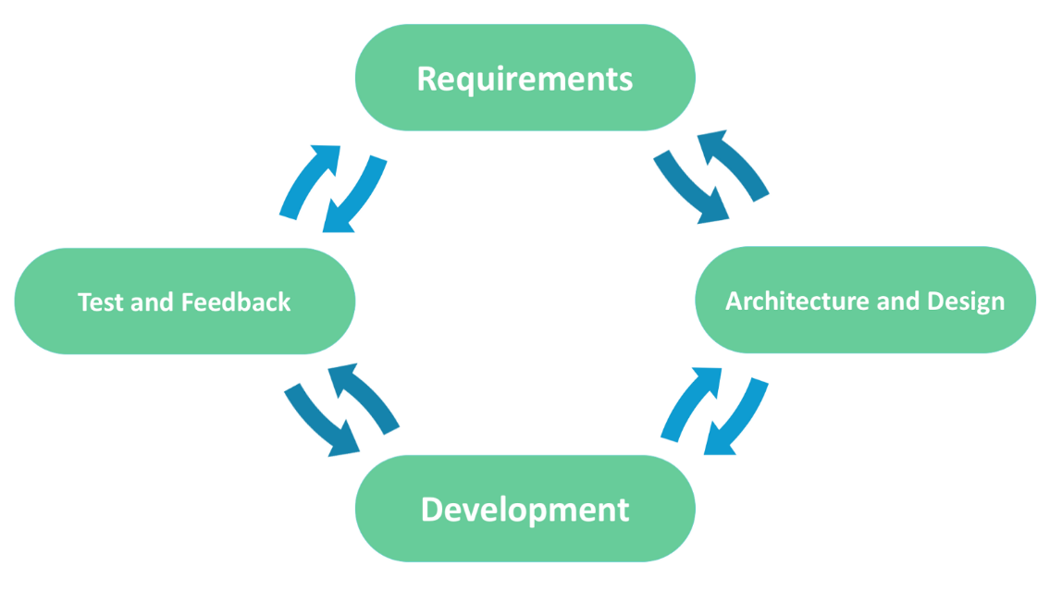
Agile Model
In the agile methodology after every development iteration, the customer is able to see the result and understand if he is satisfied with it or he is not. This is one of the advantages of the agile software development life cycle model. One of its disadvantages is that with the absence of defined requirements it is difficult to estimate the resources and development cost. Extreme programming is one of the practical use of the agile model. The basis of such model consists of short weekly meetings — Sprints which are the part of the Scrum approach.

Slide 15
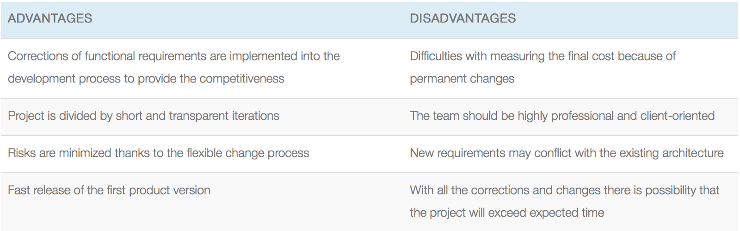
Use cases for the Agile model:
The users’ needs change dynamically
Less price for the changes implemented because of the many iterations
Unlike the Waterfall model, it requires only initial planning to start the project

Slide 16
Conclusion
Software Development Life Cycle (SDLC) is the process of developing information systems through analysis, planning, design, implementation, integration maintenance and testing of software applications.
Scope Restriction
Progressive Enhancement
Pre-defined Structure
Incremental Planning at each of the stages

Slide 17
DevOps
Kapil Thakkar
DevOps Trainer

Slide 18
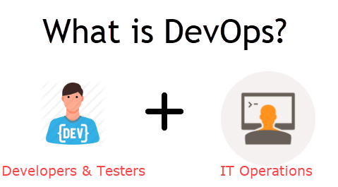
DevOps (development and operations) is an enterprise software development phrase used to mean a type of agile relationship between development and IT operations. The goal of DevOps is to change and improve the relationship by advocating better communication and collaboration between these two business units.

Slide 19
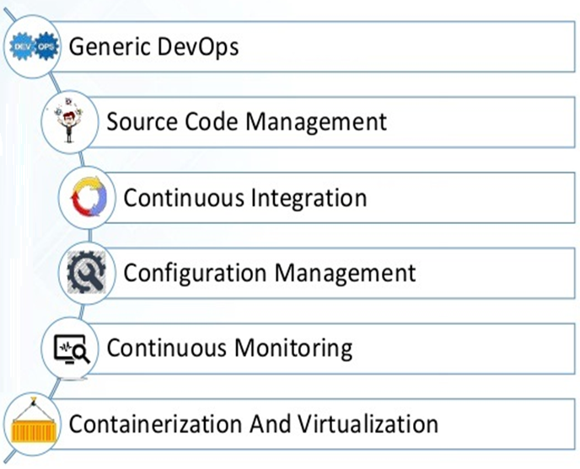

DevOps Classification

Slide 20
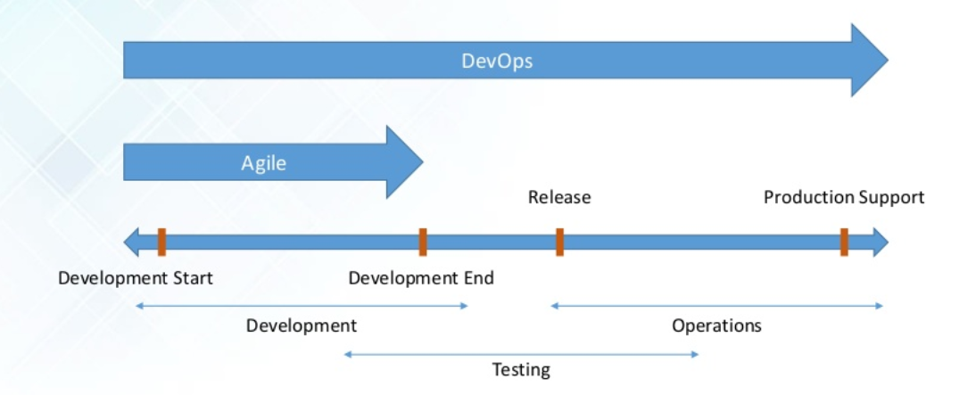
How DevOps is different from Agile

Slide 21
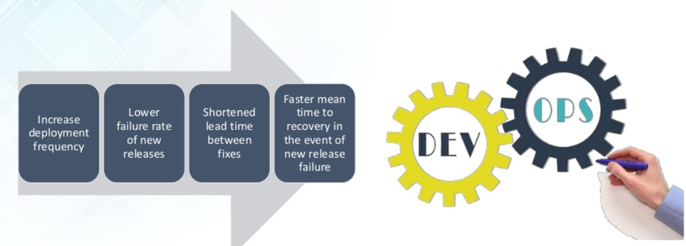
Why DevOps

Slide 22
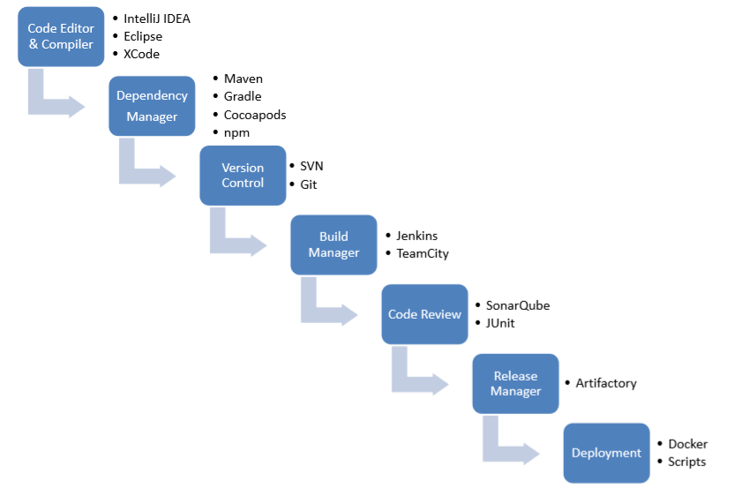
DevOps Toolchain - Lifecycle

Slide 23
Git -
( VCS / SCM )
Kapil Thakkar
DevOps Trainer

Slide 24
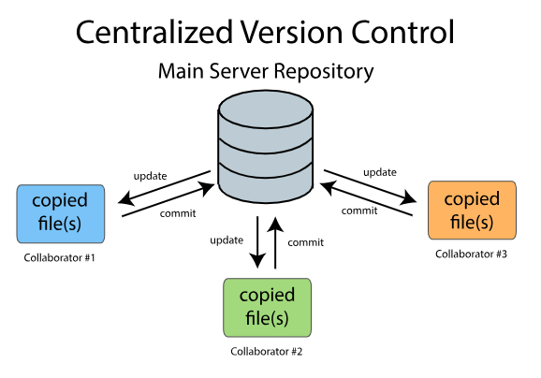
VCS (Version Control System)
Version control is a system that records changes to a file or set of files over time so that you can recall specific versions later. For the examples in this book, you will use software source code as the files being version controlled, though in reality you can do this with nearly any type of file on a computer.
VCS are sometimes known as SCM (Source Code Management) tools or RCS (Revision Control System). One of the most popular VCS tools in use today is called Git. Git is a Distributed VCS, a category known as DVCS, more on that later. Like many of the most popular VCS systems available today, Git is free and open source.

Slide 25
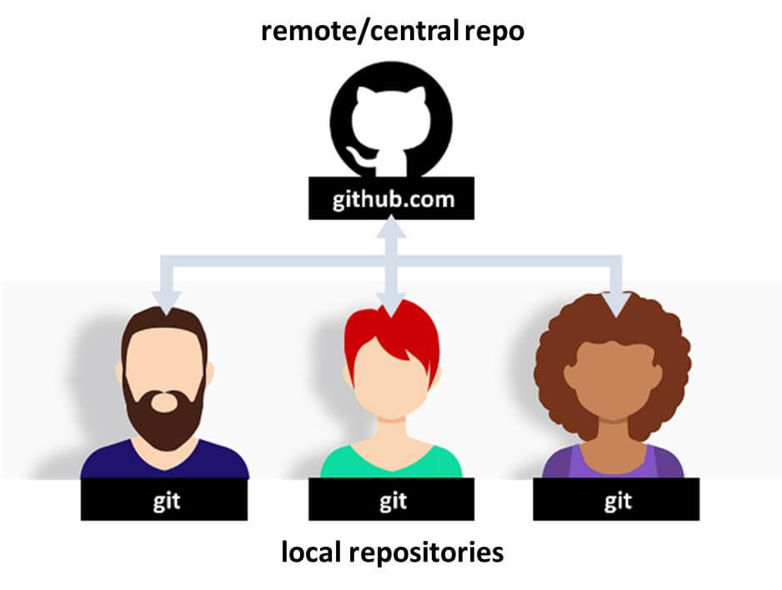
Git and GitHub
Git is a revision control system, a tool to manage your source code history. GitHub is a hosting service for Git repositories. So they are not the same thing: Git is the tool, GitHub is the service for projects that use Git.

Slide 26
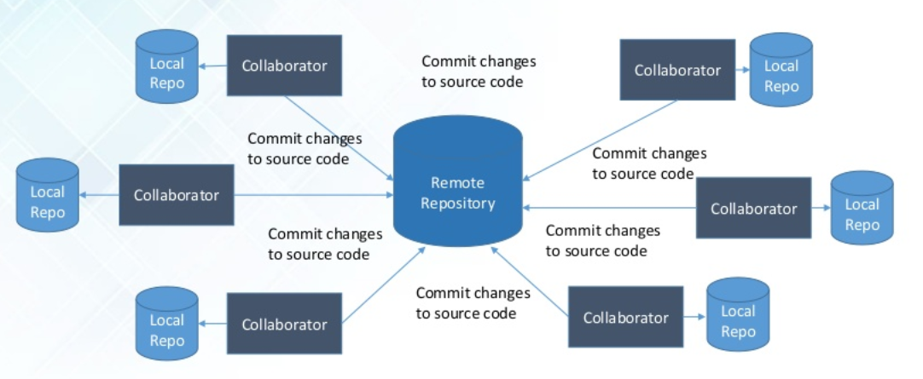
Git Distributed Architecture

Slide 27
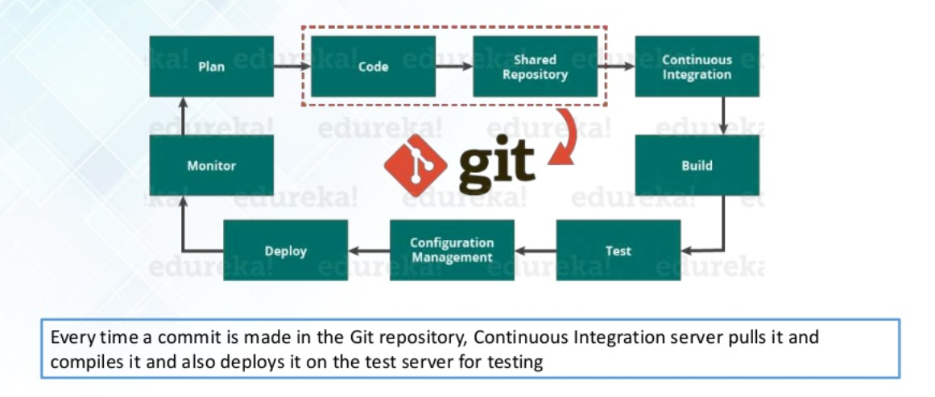
How git performs in DevOps

Slide 28
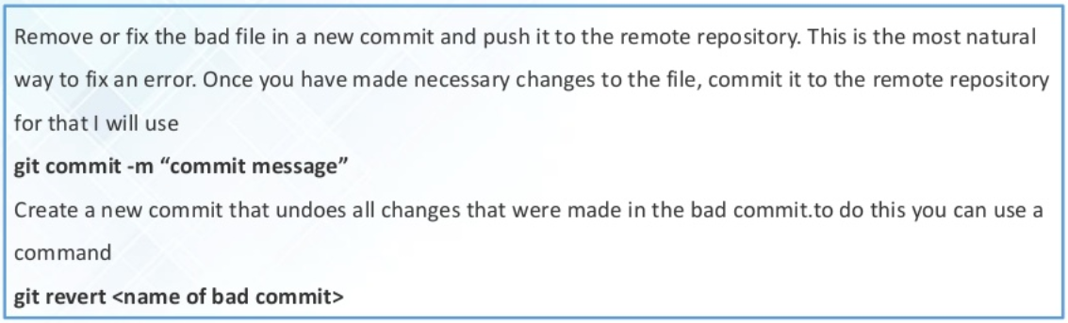
Revert commit in git

Slide 29
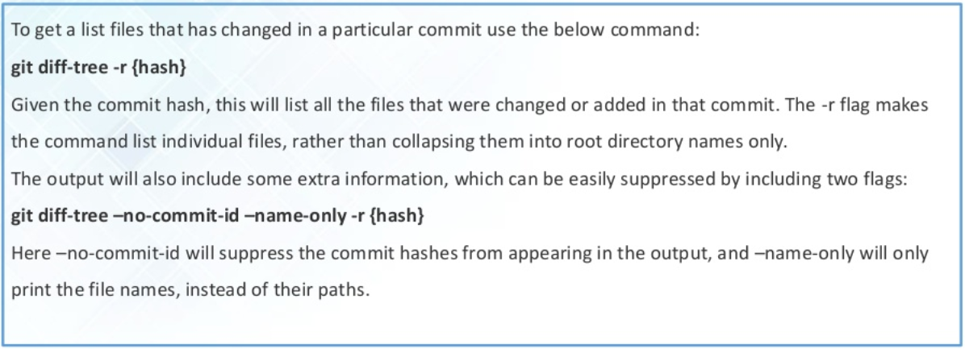
Git - Find list of files in changed in particular commit

Slide 30
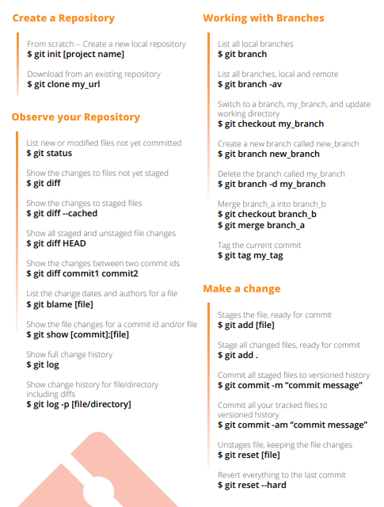
Git Commands

Slide 31
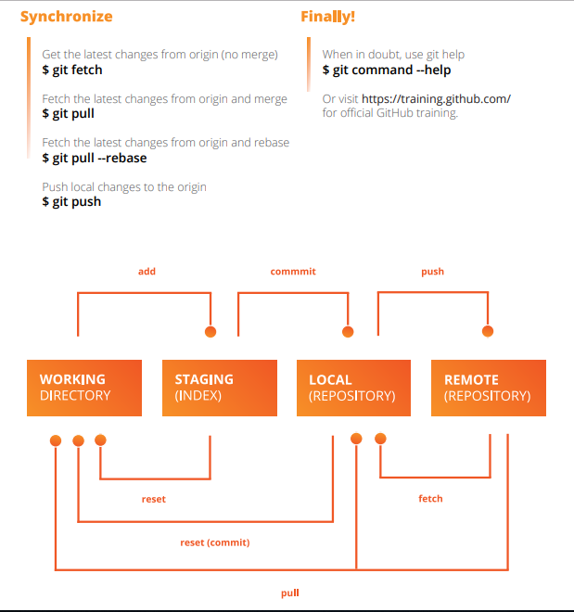
Git Commands

Slide 32
Reference Links
# Installations:
https://git-scm.com/downloads
https://confluence.atlassian.com/bitbucketserver/basic-git-commands-776639767.html
# Example:
https://github.com/kapilsthakkar25

Slide 33
Containerization
Kapil Thakkar
DevOps Trainer

Slide 34
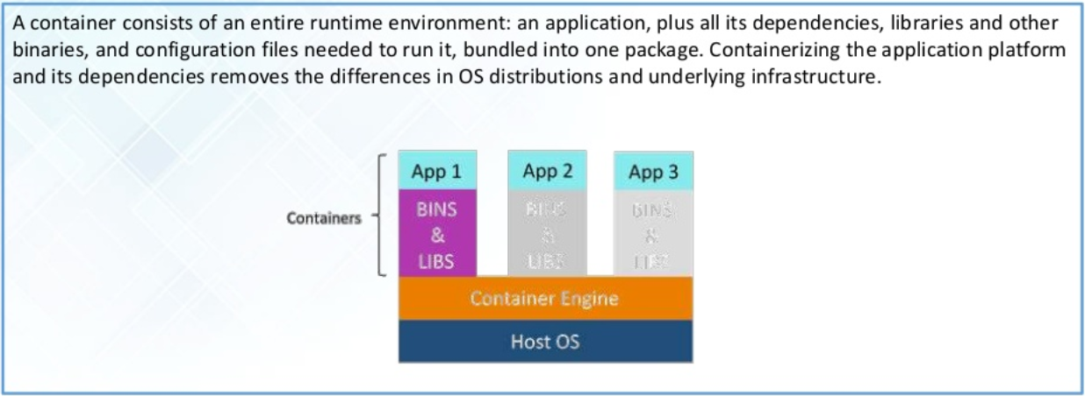
What are Containers?

Slide 35
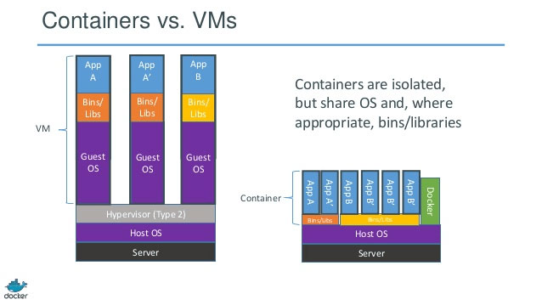
Docker Containers vs VMs
Docker is an open platform for developers and system admins to build, ship, and run distributed applications, whether on laptops, data canter VMs, or the cloud

Slide 36
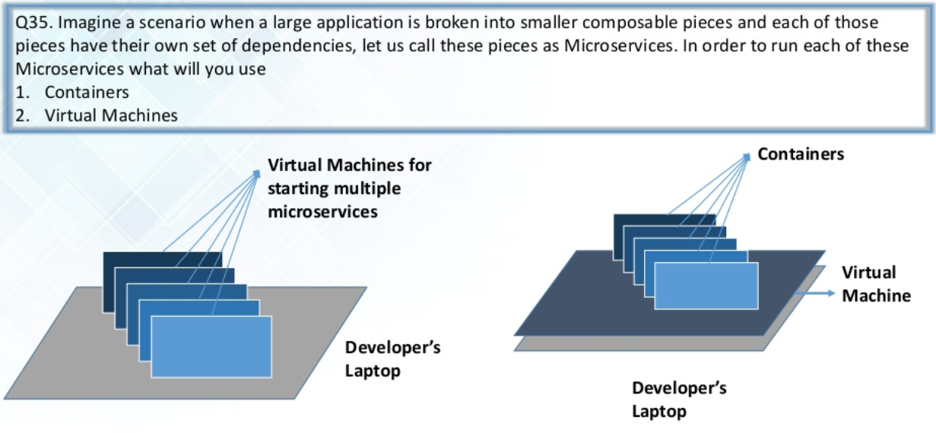

Slide 37
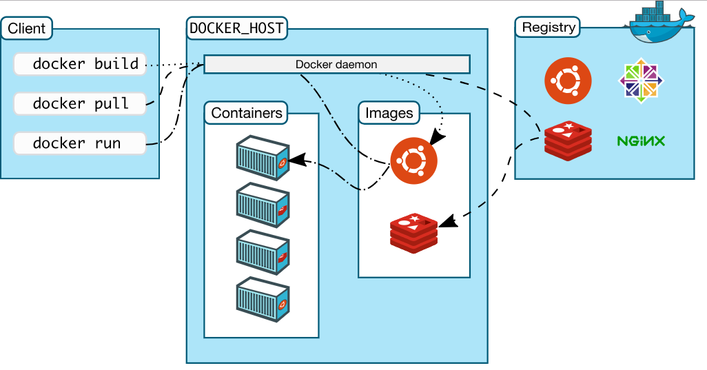
Docker Architecture

Slide 38
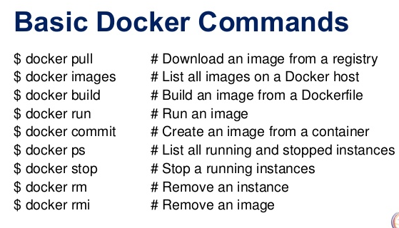

Slide 39
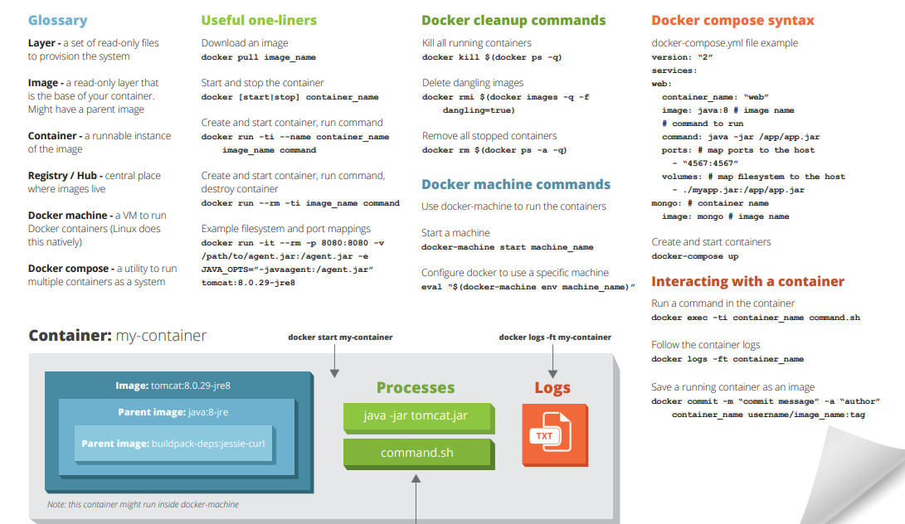

Slide 40
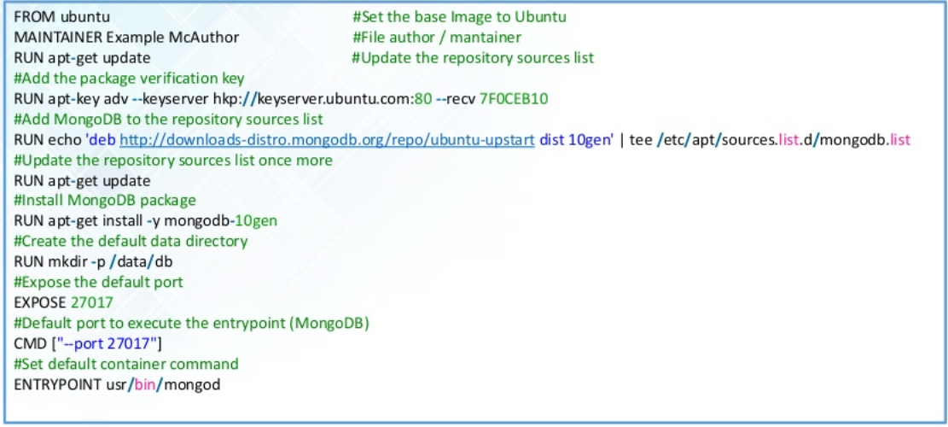
Dockerfile for MongoDB

Slide 41
Dev / Staging
Web
DB
Production
Web
Web
Web
Web
DB
DB
master
slave

Slide 42
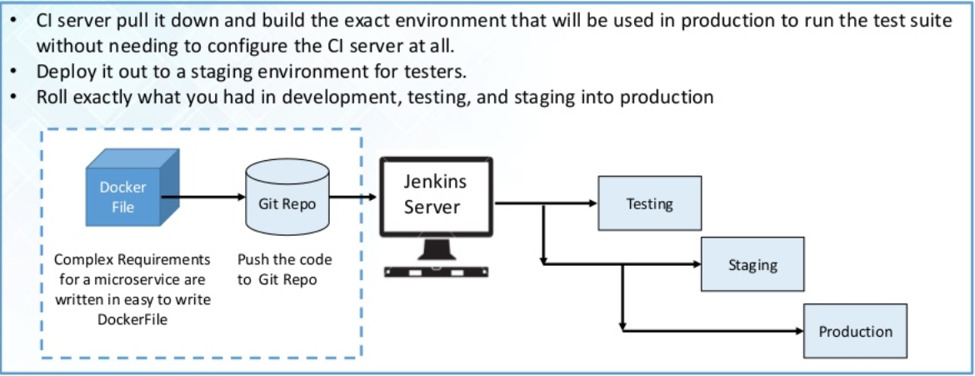
How docker is use in SDLC?

Slide 43
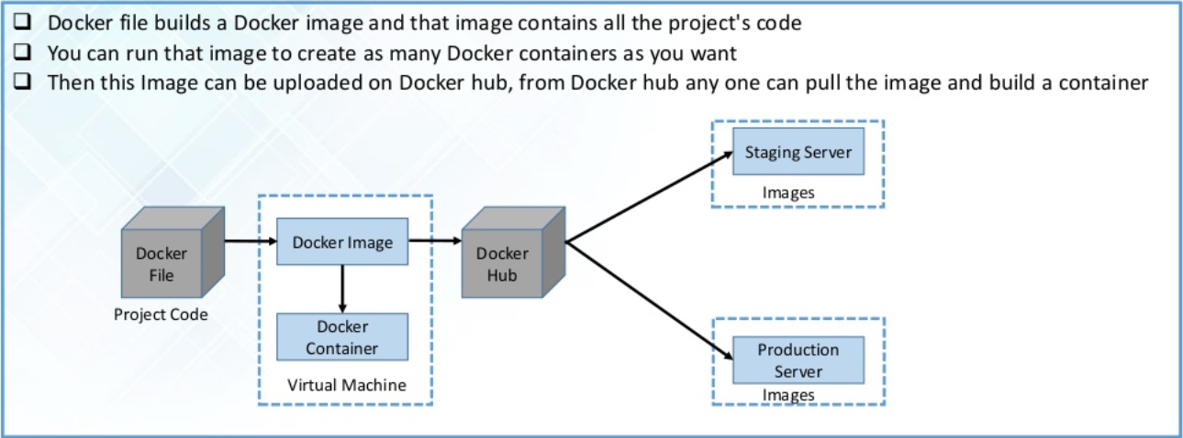
Docker provides consistent computing environment throughout the SDLC

Slide 44
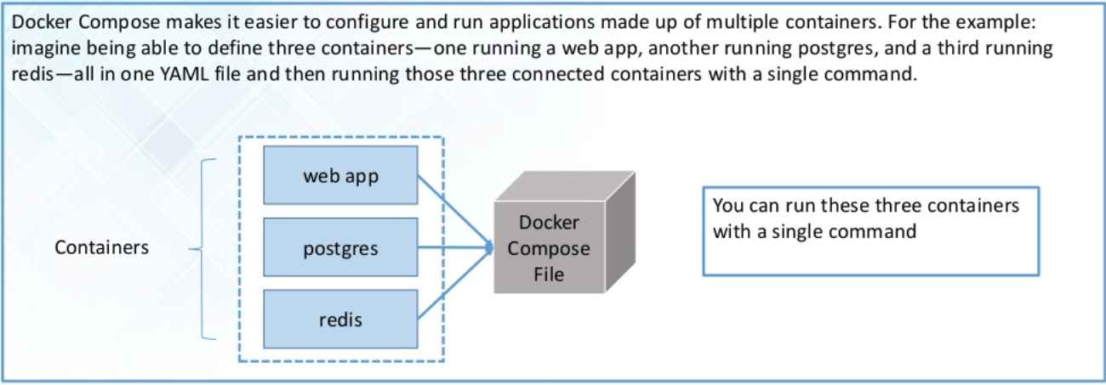
What is Docker compose

Slide 45
Reference Links
# Installations:
https://docs.docker.com/install/linux/docker-ce/centos/
https://www.docker.com/products/docker-desktop
https://docs.docker.com/develop/develop-images/dockerfile_best-practices/
https://www.tutorialspoint.com/docker/docker_compose.htm
# Docker Hub
https://hub.docker.com/
https://cloud.docker.com/u/kapilsthakkar25/repository/docker/kapilsthakkar25/spaceshooter
# Git Example:
https://github.com/kapilsthakkar25/webapp-repo
https://github.com/kapilsthakkar25/docker-mysql-php-example
https://github.com/kapilsthakkar25/docker-wordpress
https://github.com/kapilsthakkar25/space-shooter
https://github.com/kapilsthakkar25/docker-nginx-php-mysql
https://github.com/kapilsthakkar25/docker-repo

Slide 46
Kubernetes
Kapil Thakkar
DevOps Trainer

Slide 47
What is Kubernetes?
Kubernetes(K8S) is an open source tool for managing containerised workloads. It operated at the container(not hardware) level to automate the deployment, scaling and management of applications. ▹ K8S works alongside a containerization tool, like Docker. So if containers are the ‘Ingredients’ of an application, then K8S would be the ‘Chef or Ansible’
As well as managing individual containers, K8S can also manage clusters:
￭ A cluster is a series of servers connected to run containers.
￭ K8S can scale upto 5000 server and 150,000 pods in a single cluster.
￭ A pod is a group of containers that share resources, a network and can communicate with one another

Slide 48
Why use k8s?
As an orchestration platform, K8S provides features to make the management, maintenance and life-cycle of containers easier than using a container-engine alone.
▹ Horizontal Scaling
▹ Self Healing
▹ Automated Rollouts
▹ Various other features like Service Discovery and load balancing etc.

Slide 49
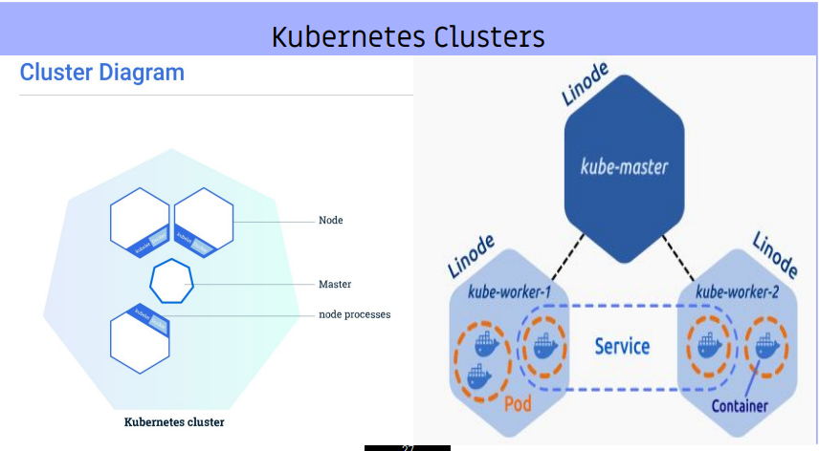
Kubernetes Cluster
Containerised applications are deployed with K8S into highly available clusters
▹ Clusters run over several computers called Worker Nodes, that are connected to work as a single unit.
▹ Containerised apps are automatically distributed among the Worker Nodes at deploy time.
▹ A Master Node manages the cluster - coordinating scheduling, scaling and rolling updates.

Slide 50
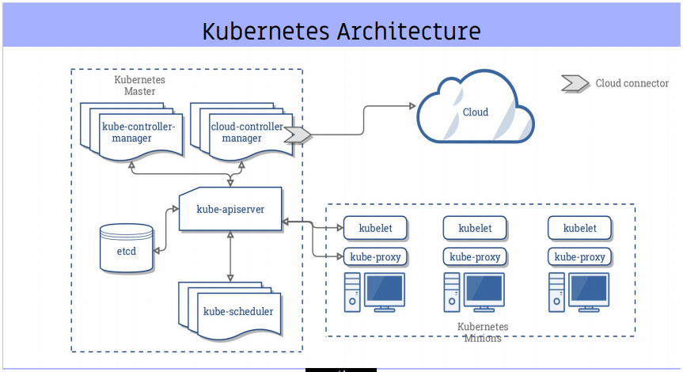

Slide 51
Reference Links
# Installations:
https://kubernetes.io/docs/setup/independent/install-kubeadm/
https://kubernetes.io/docs/setup/independent/create-cluster-kubeadm/
https://kubernetes.io/docs/tasks/access-application-cluster/web-ui-dashboard/
https://kubernetes.io/docs/tasks/tools/install-kubectl/
https://github.com/kapilsthakkar25/kubernetes-demo/blob/master/basic-example4.txt
# Interactive Tutorials and Tasks:
https://kubernetes.io/docs/tutorials/kubernetes-basics/deploy-app/deploy-interactive/
https://kubernetes.io/docs/tasks/
# Git Example:
https://github.com/kapilsthakkar25/kubernetes-demo

Slide 52
IaC -
Infra as a Code
Kapil Thakkar
DevOps Trainer

Slide 53
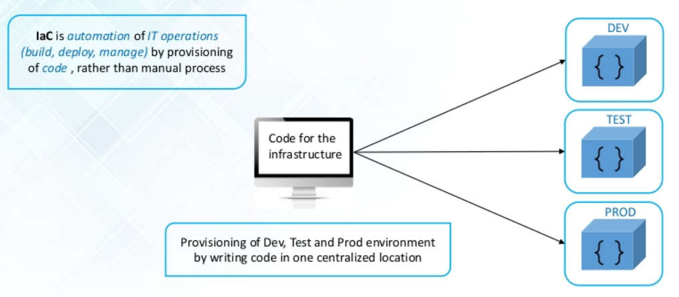
Infra as a Code (IaC)

Slide 54
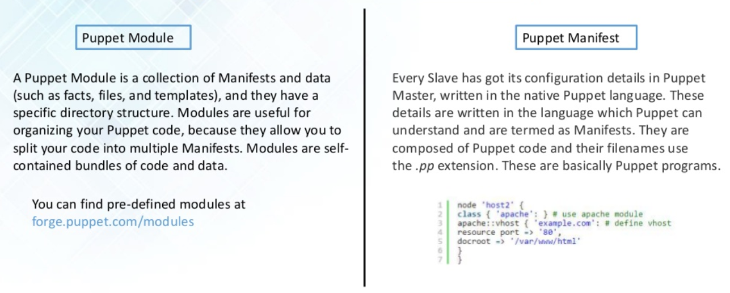
Puppet module and manifest

Slide 55
What is Ansible
Ansible is an open-source IT automation engine, which can remove drudgery from your work life, and will also dramatically improve the scalability, consistency, and reliability of your IT environment. We’ll start to explore how to automate repetitive system administration tasks using Ansible, and if you want to learn more, you can go much deeper into how to use Ansible with Cloud Academy’s new Introduction to Ansible learning path.
You can use Ansible to automate three types of tasks:
Provisioning: Set up the various servers you need in your infrastructure.
Configuration management: Change the configuration of an application, OS, or device; start and stop services; install or update applications; implement a security policy; or perform a wide variety of other configuration tasks.
Application deployment: Make DevOps easier by automating the deployment of internally developed applications to your production systems.
Ansible can automate IT environments whether they are hosted on traditional bare metal servers, virtualization platforms, or in the cloud. It can also automate the configuration of a wide range of systems and devices such as databases, storage devices, networks, firewalls, and many others.

Slide 56
Why Ansible
There are many other IT automation tools available, including more mature ones like Puppet and Chef, so why would you choose Ansible? The main reason is simplicity. Michael DeHaan, the creator of Ansible, already had a lot of experience with other configuration management tools when he decided to develop a new one. He said that he wanted “a tool that you could not use for six months, come back to, and still remember.”
DeHaan accomplished this by using YAML, a simple configuration language. Puppet and Chef, on the other hand, use Ruby, which is more difficult to learn. This makes Ansible especially appealing to system administrators.
DeHaan also simplified Ansible deployment by making it agentless. That is, instead of having to install an agent on every system you want to manage (as you have to do with Puppet and Chef), Ansible just requires that systems have Python (on Linux servers) or PowerShell (on Windows servers) and SSH.

Slide 57
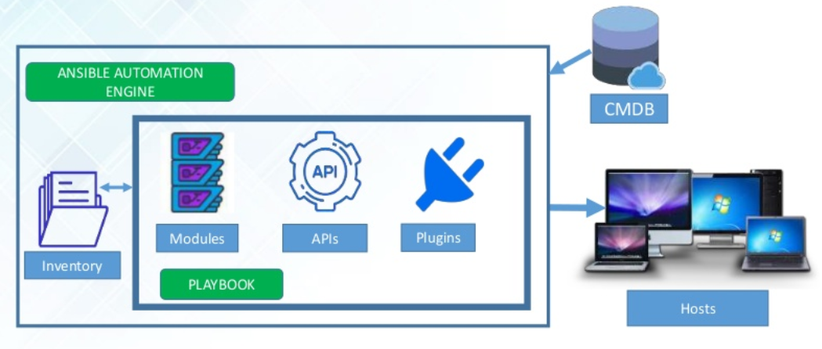
Ansible Architecture

Slide 58
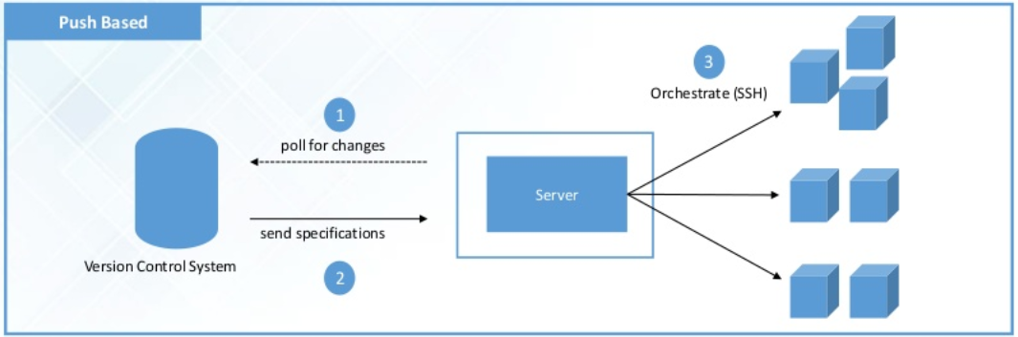
Ansible is Push based CM tool

Slide 59
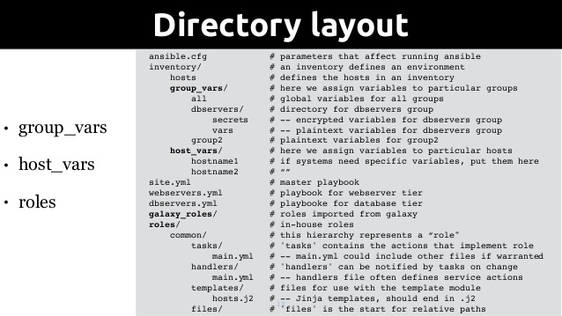

Slide 60
Reference Links
# Installations:
https://docs.ansible.com/ansible/latest/installation_guide/intro_installation.html
https://docs.ansible.com/ansible/latest/user_guide/quickstart.html
# Git Example:
https://github.com/kapilsthakkar25/ansible-project

Slide 61
CI -
Continuous Integrations
Kapil Thakkar
DevOps Trainer

Slide 62
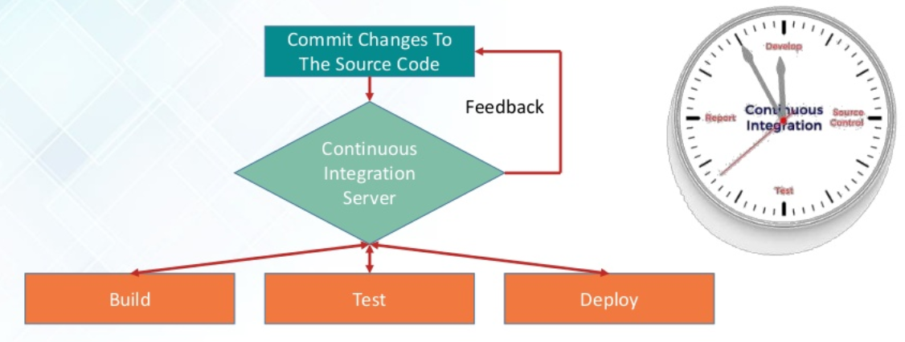
What is Continuous Integration

Slide 63
Jenkins Intro
Jenkins is an open source implementation of a CI server written in Java that can be used as a self-hosted option automating the build cycle for any project. It works with any programming language and for multiple platforms including Windows, Linux and macOS.
One of the main benefits of Jenkins is that it is a well-known tool with lots of community support, there are many plugins available (including well-known names like Slack, GitHub, Docker, Build Pipeline + more), and the project is well-maintained by a large community of developers.

Slide 64
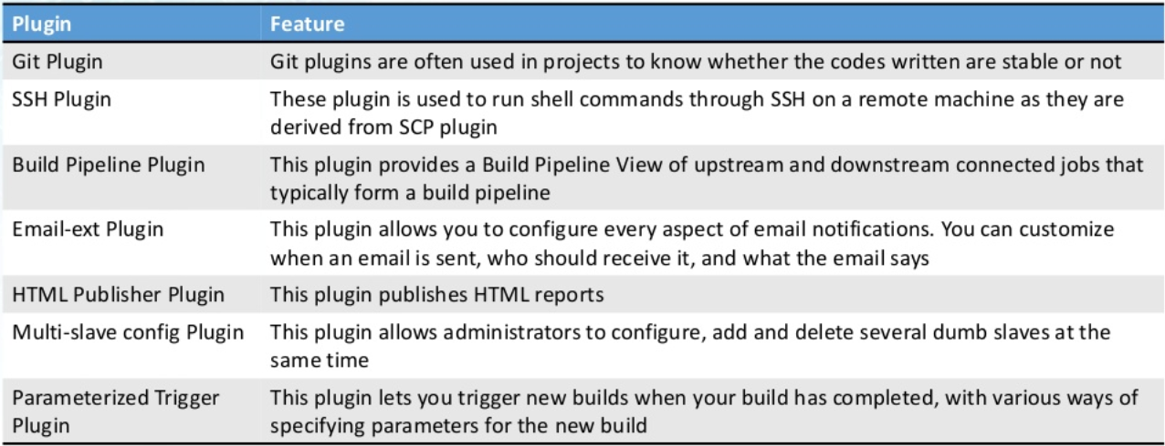
Common Jenkins Plugins

Slide 65
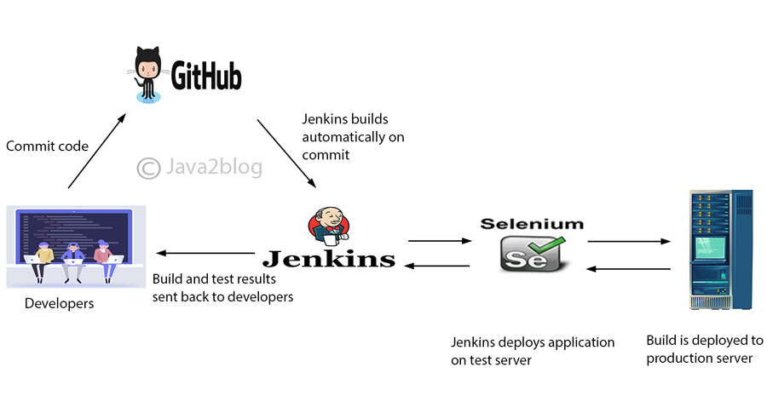
Jenkins with GitHub

Slide 66
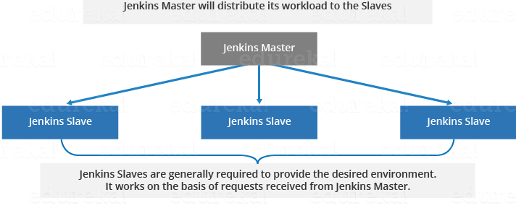
Jenkins Master and Slave

Slide 67
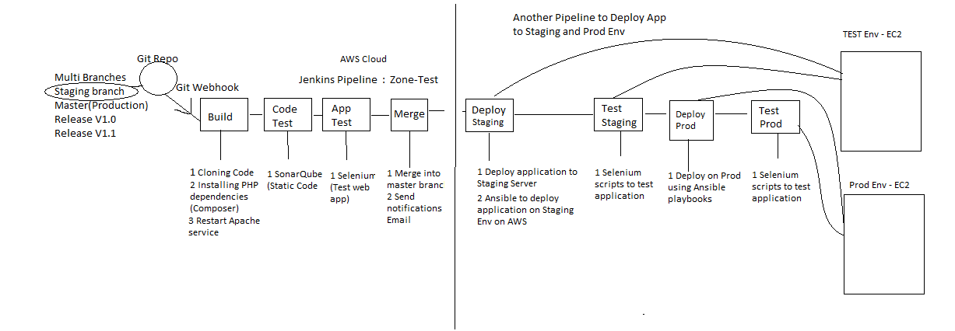
Jenkins Pipeline Example

Slide 68
Reference Links
# Installations:
https://linuxize.com/post/how-to-install-jenkins-on-centos-7/
https://hub.docker.com/_/jenkins
# Git Example:
https://github.com/kapilsthakkar25/my-app
https://github.com/kapilsthakkar25/jenkins-lab-demo
https://github.com/kapilsthakkar25/pipeline-examples
https://github.com/kapilsthakkar25/simple-java-maven-app
https://github.com/kapilsthakkar25/spring-jenkins
https://github.com/kapilsthakkar25/maven-project

Slide 69
Continuous Monitoring
Kapil Thakkar
DevOps Trainer

Slide 70
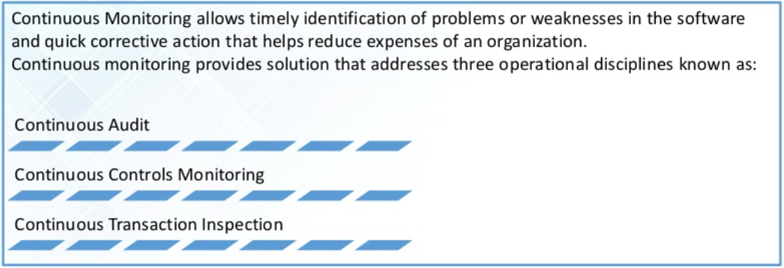
Continuous Monitoring

Slide 71
What is Nagios?
Nagios is used for Continuous monitoring of systems, applications, services, and business processes etc in a DevOps culture. In the event of a failure, Nagios can alert technical staff of the problem, allowing them to begin remediation processes before outages affect business processes, end-users, or customers. With Nagios, you don’t have to explain why an unseen infrastructure outage affect your organization’s bottom line.

Slide 72
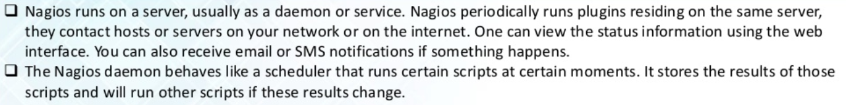
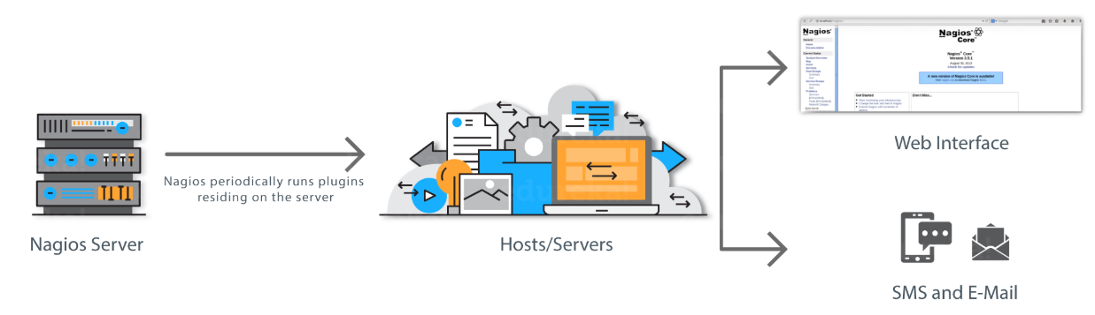
How Nagios works

Slide 73
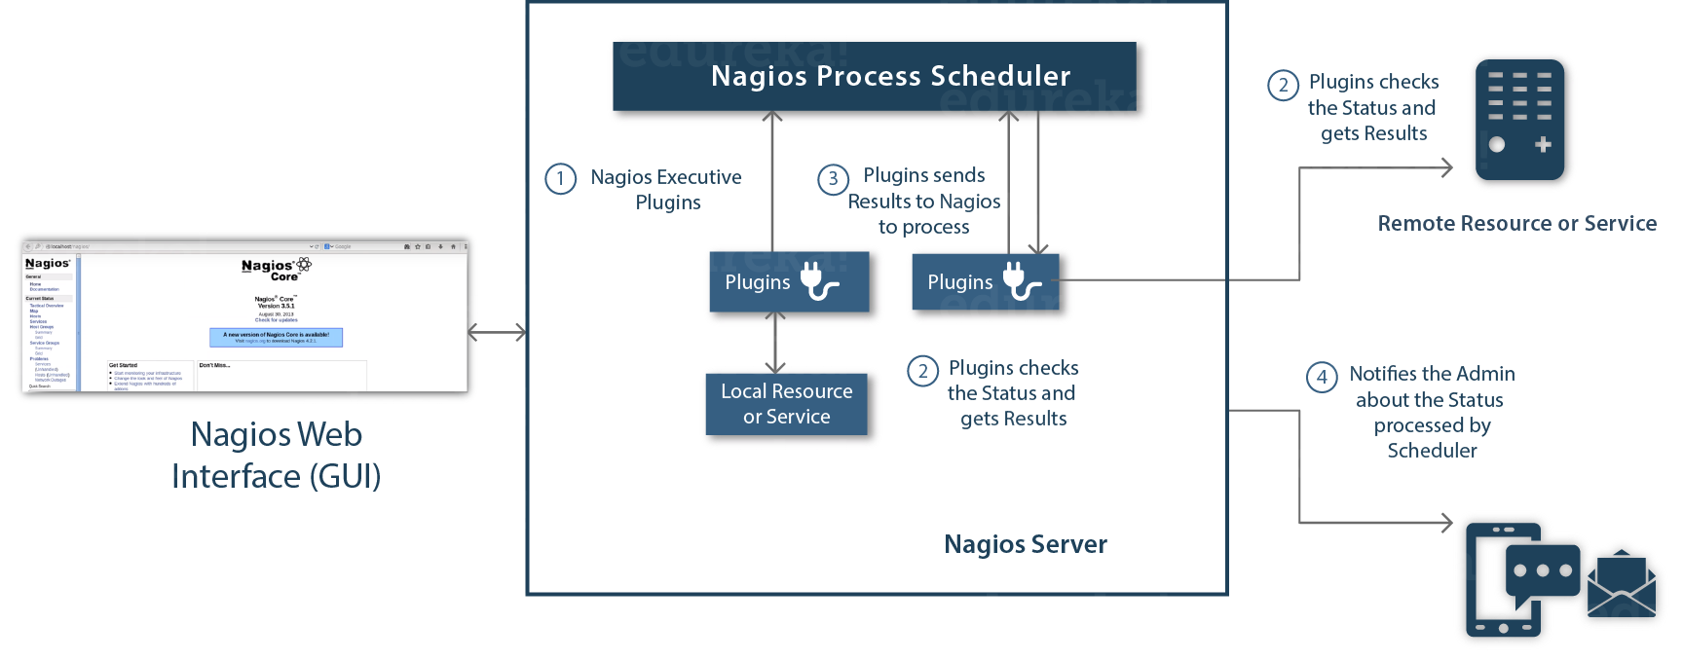
Nagios Architecture
Nagios is built on a server/agents architecture.
Usually, on a network, a Nagios server is running on a host, and Plugins interact with local and all the remote hosts that need to be monitored.
These plugins will send information to the Scheduler, which displays that in a GUI.

Slide 74
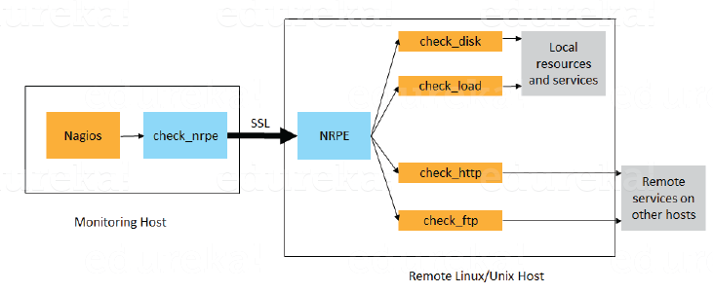
What is NRPE
NRPE (Nagios Remote Plugin Executor)
The NRPE addon is designed to allow you to execute Nagios plugins on remote Linux/Unix machines. The main reason for doing this is to allow Nagios to monitor “local” resources (like CPU load, memory usage, etc.) on remote machines. Since these public resources are not usually exposed to external machines, an agent like NRPE must be installed on the remote Linux/Unix machines.

Slide 75
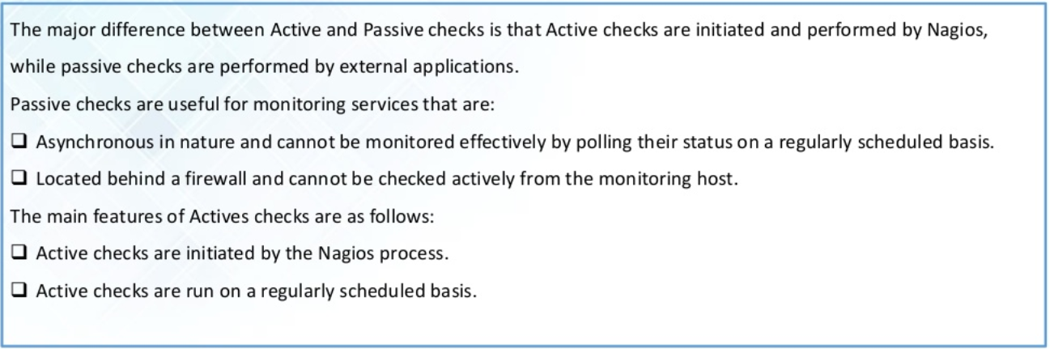
Active and Passive in Nagios

Slide 76
Reference Links
# Installations:
https://github.com/kapilsthakkar25/nagios-eample/blob/master/nagios-server-install.txt
https://github.com/kapilsthakkar25/nagios-eample/blob/master/Install-Nagios-Agent-on-client.txt
https://www.nagios.org/
https://assets.nagios.com/downloads/nagioscore/docs/nagioscore/4/en/toc.html
# Git Example:
https://github.com/kapilsthakkar25/nagios-eample

Slide 77
Thanks…!!!
Contact Details:
Name: Kapil Thakkar (DevOps Trainer)
Email ID: kapilsthakkar25@gmail.com
GitHub Repo: https://github.com/kapilsthakkar25

